Slide 1
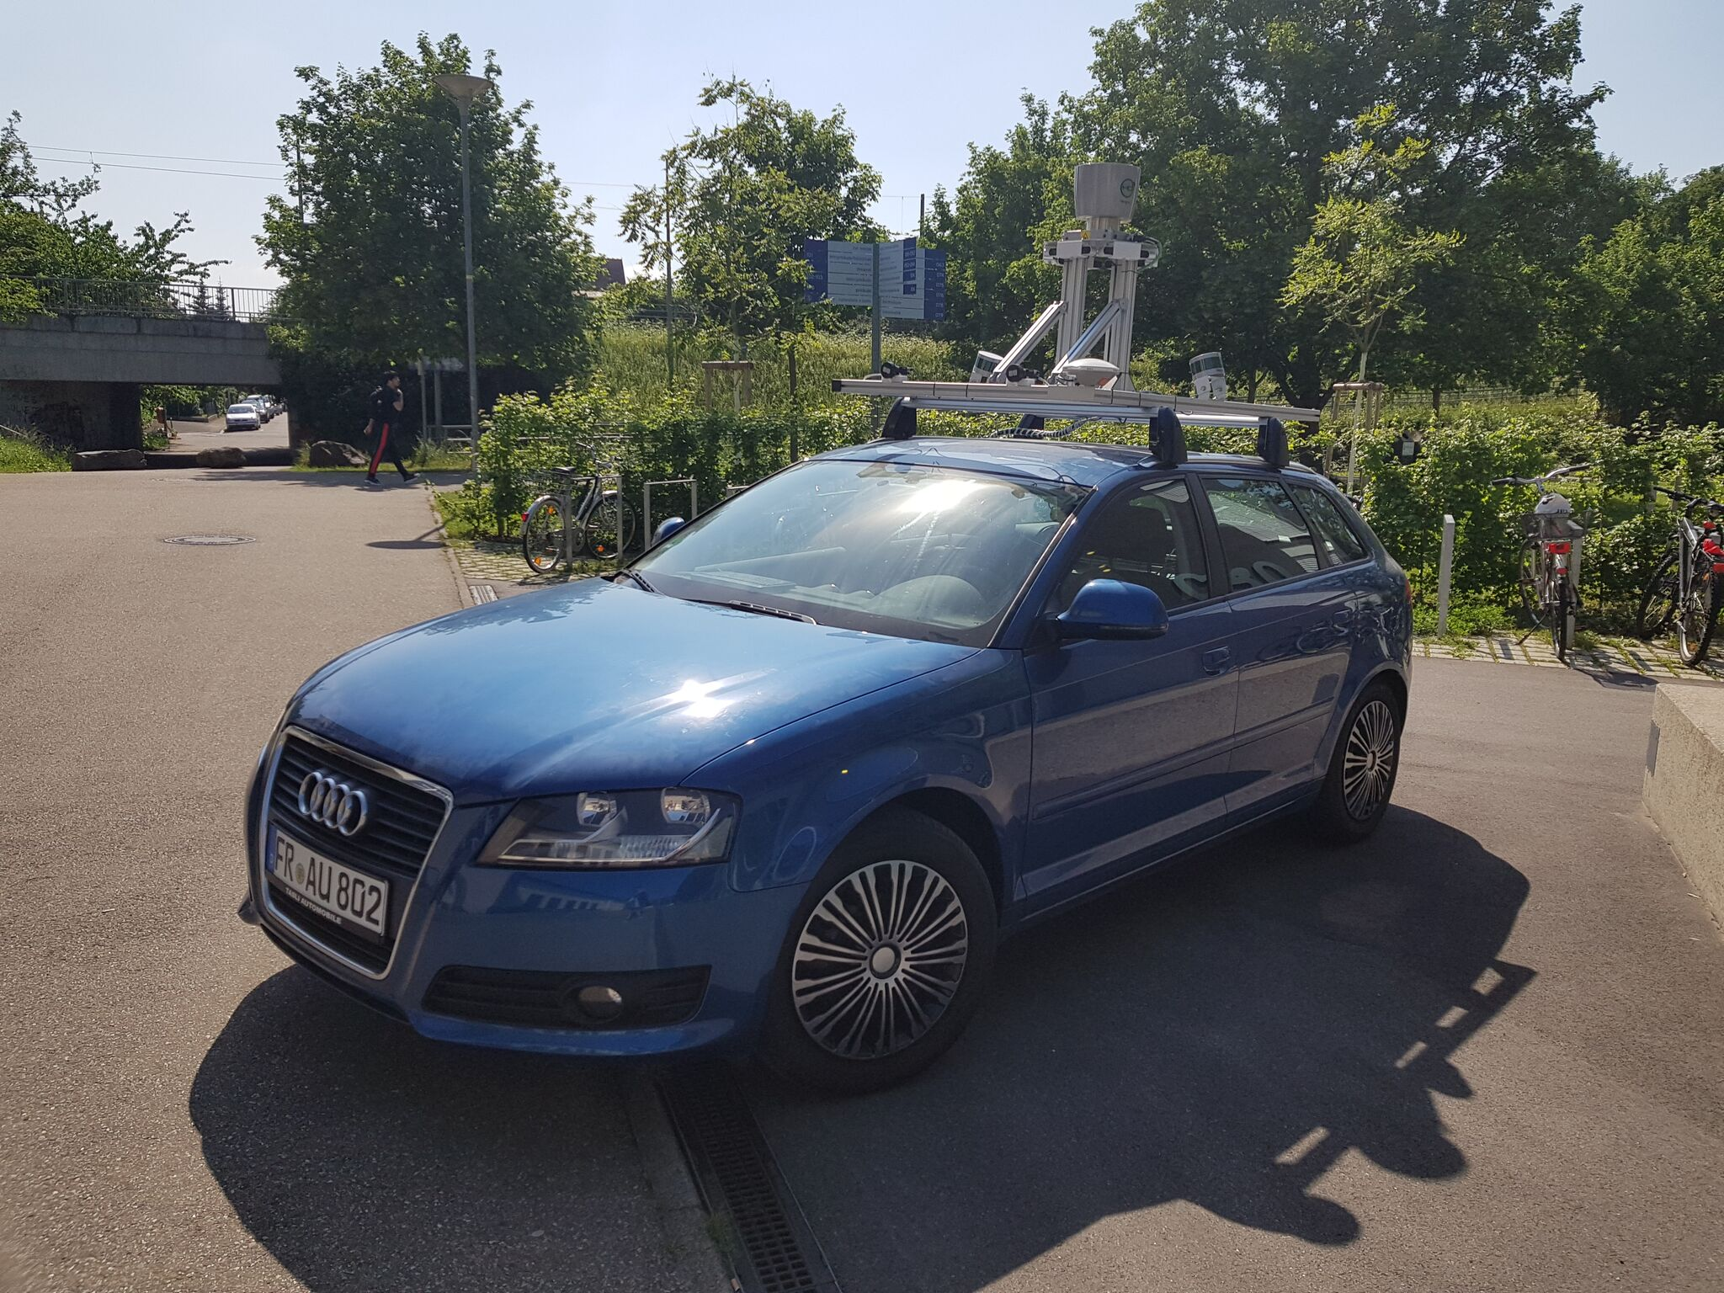
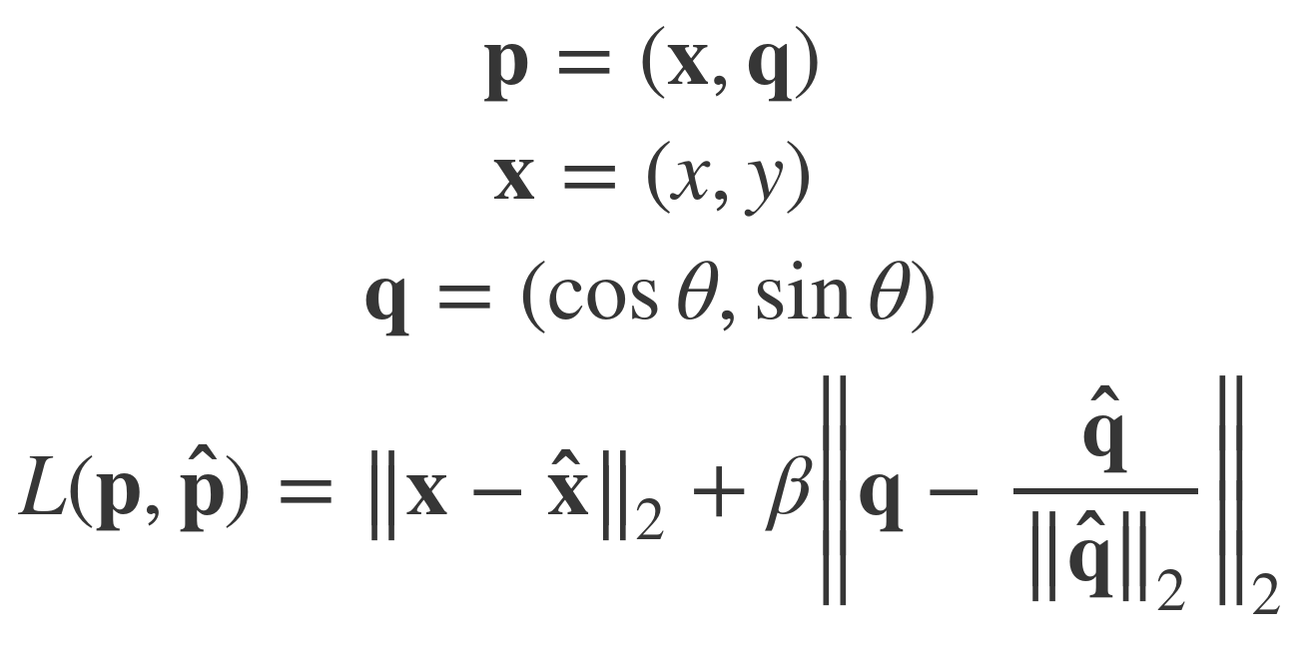

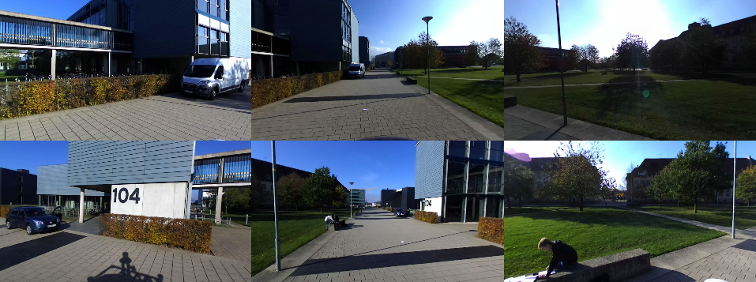
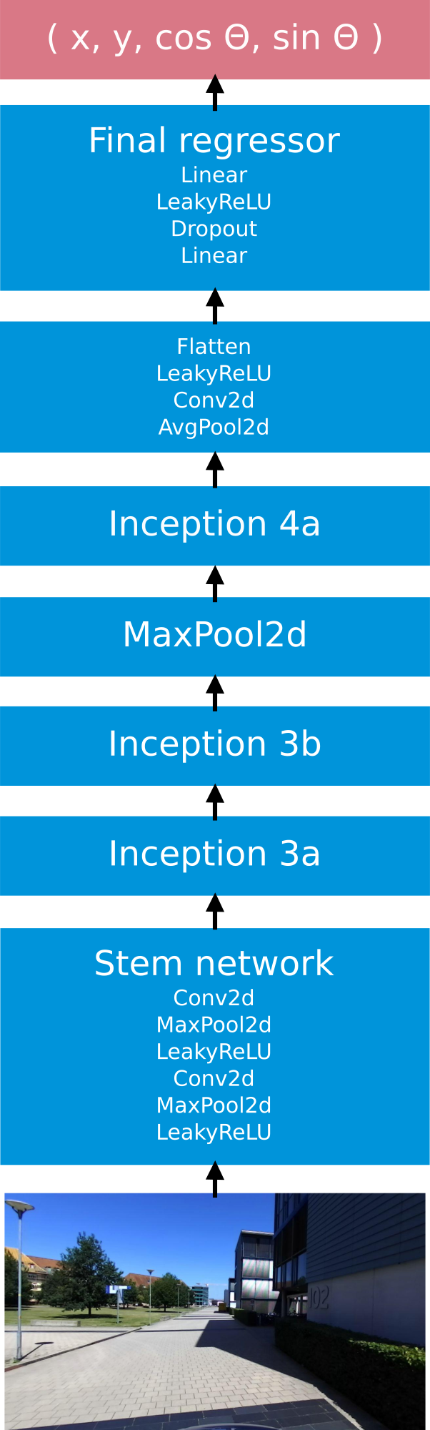
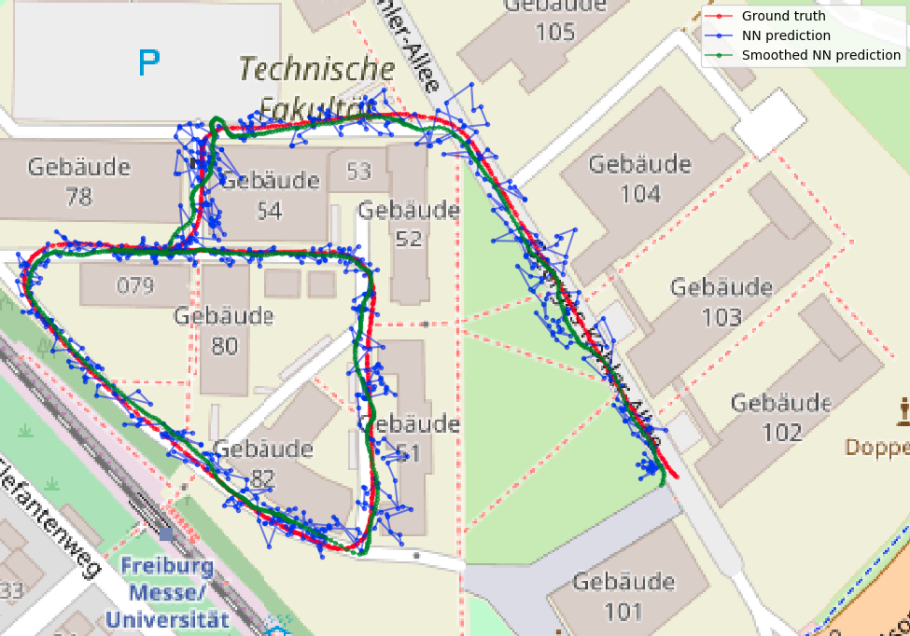
Vision-based localization
Borna Bešić & Fabian Stiller
Project goals
Regress pose vector from AIS Perception Car image data using a deep neural network
Compare two input models:
only front camera
six cameras covering 360°
Smooth the trajectory given by the neural network
Dataset
~ 9000 poses around Faculty of Engineering Campus with GPS data:
Universal Transverse Mercator (UTM) geographical coordinates
Quaternion orientation
Spatial extent: 300 m x 300 m (90000 m²)
For six cameras input model, images were concatenated along the channel axis resulting in a single image with 3 x 6 = 18 channels
Neural network architecture
PoseNet up to the first regressor
Model size: ~ 9 MiB
Loss function: combined position vector L2 loss and orientation vector L2 loss with a weighting factor β
FRONT
LEFT
FRONT
CENTER
FRONT
RIGHT
BACK
LEFT
BACK
CENTER
BACK
RIGHT
Experimental results
Median position and orientation errors:
Front camera: 3.84 m, 3.97°
All cameras: 4.77 m, 2.71°

Slide 4


